Slide 1
Romans 8:12-25

Slide 2
The Facts
Year-Around 57AD
Setting-Most likely In Corinth or Cenchrea ( 6 Miles away)
Plot-All men have sinned, but all can be saved.
Theme-Romans 1:16-17.
-Salvation for all of mankind is available
-Justified by faith in Jesus Christ

Slide 3
Review
Chapter 1-Man is evil because he has chosen to be, and God will not force His love upon them.
Key Verses
Chapter 1
-5-7: Introduction to Romans and seeing Paul’s desire to Bring the Gospel to all nations
Writes in letter Formatting and addresses whom he is speaking to (Romans).
-16-17: The Theme of the book. Paul uses teach chapter to further explain.
-18-19,21: Paul Addresses the natural tendency of each man in and why we see an experience such things as death, sin, etc.
-24-25: We see God’s love on man as man chooses to be unclean. God will not force His love.

Slide 4
Chapter 2
Because Man is evil, God must Judge them. Whether Jew Or Greek we have all sinned and cannot be saved by our own merits.
Key Verses
-1-4: We shall be judged according to our actions. But through repentance God offers a way out.
-17-21: Paul is referring to Jews being sinful as well. Those who pride themselves upon their own deeds will still fall short.
-29: Paul discusses the ordeal of circumcision. Even though one may be circumcised, he is not saved from his unlawful acts. We are not saved by works.

Slide 5
Chapter 3
Chapter 3- God will keep His promises to the Jews. Both Jew(circumcised) and Greek(uncircumcised) alike are given a way by redemption and putting our faith in Jesus Christ.
Key Verses
-1-4: God will fulfill His promises to the Jews as a nation, though many individually do not believe it.
-9,20: God gave us a law to abide and live by. All men have broken it more than once. It is the ultimate standard for living perfectly, and yet, man cannot keep it.
-23-25: Paul addresses the way out in Chapter 2. Though we are faulty, we can be restored.
-28,30: God saves both Jews and Greek by way of Faith(1:17) in Jesus Christ.

Slide 6
Chapter 4
Chapter 4- It is by Faith we are saved. That choice given by God to accept Christ as a means of redemption as seen with Abraham and David.
Key Verses
-3-4: Abraham was saved by his faith, not his works
-6-8: Daniel also shares the same truth
-11: Whether circumcised or uncircumcised, God used Abraham and his faith to bring forth Jesus and all those who believe in Jesus.

Slide 7
Chapter 5
Chapter 5-As believers we can recognize what God accomplished even by man’s downfall. It is through Jesus that it was accomplished.
Key Verses
-1-4: Because we have believed we can rejoice in what God has done. Even through trials, God shall build us up.
-6,8-9: Christ came to complete that which was incomplete. By His death, we have the capability to live. He took His own life for our resurrection in Him.
-12,14-15,21: Adam sinned. This is why we see the state of death the world is in. But God continues to never fail, by sending Jesus to makeup Adams wrong. Jesus’ sacrifice reconciled us to God.

Slide 8
Chapter 6
Chapter 6-When we surrender to Christ, we dire to ourselves and our old lifestyle. As believers we are called to worship Christ with our bodies. We see that every man must choose who they will follow and their choice shall be known by their fruits.
Key Verses
-2,4-5,9: As believers once we commit our spirits to Christ we engage in the death he died BY no longer living according to the flesh. We are made new.
-12-13: We are called to use out bodies to glorify God. We give up out old selves for the sake of what God has for us.
-16: Paul addresses the choice we must make as humans. Choose whom we shall serve. God or our natural, sinful ways, the flesh. Jesus is what sets us apart.
-22-23: We shall be known by our fruits and the only way to produce good fruit is to accept the gift of eternal life by way of Christ.

Slide 9
Chapter 7
Chapter 7: We no longer have to complete the law hopelessly. Even though man is evil and we fall tempted, if our hearts are surrendered to Christ, so shall everything else follow.
Key Verses
-1,5-6: Paul shows our freedom from completing the law perfectly given to us by God. Though we have seen man is not capable of being perfect.
-8,10-11: The law is not evil, but in our fallen state of being we become temped to do that which we know to be wrong. Pushing that line as far as we can.
-14,19: As Christians we now desire to do good, but we too can be struggling with sin’s presence, for we are still men.
-23-25: Even our minds can be taken captive, but if our hearts focus, out minds follow. Only by trusting God can we be delivered from our evil selves and thoughts.

Slide 10
Chapter 8 review
Key Verses
Verse-1,5-11: As believers we are no longer condemned because we are in Christ. Christ heals our spirits, minds, and bodies. In all these area we are make alive in Him.

Slide 12
Defining Adoption
To Choose or take as one’s own; make one’s own by selection or assent
To take and raise as one’s own child, specifically by a formal legal act.
To take or receive into any kind of new relationship
To select a requirement for a course
To vote to accept
To accept or act in accordance with

Slide 14
Brethren
Brethren Adelphos- kindred or one like another

Slide 15
The Main Thing
“For I am not ashamed of the gospel of Christ, for it is the power of God to salvation for everyone who believes. For the Jew first and also for the Greek. For in it is the righteousness of God revealed from faith to faith; as it is written, ‘The just shall live by faith.’” – Rom. 1:16-17

Slide 16
“For God has not given us a Spirit of fear, but of power and of love and of a sound mind.” - 2 Timothy 1:7

Slide 17
“He who did not spare His own son, but delivered Him up for us all, how shall He not with Him also freely give us all things?” - Romans 8:32

Slide 18
“But each one is tempted when he is drawn away by his own desires and enticed. Then, when desire has conceived, it gives birth to sin; and sin, when it is fully grown, brings forth death.” - James 1:14-15

Slide 20
Westminster Shorter Catechism of 1674- “Q: What is adoption?
A: Adoption is an act of God’s FREE grace, whereby we are received into the number, and have a right to all the privileges of the Sons of God.”

Slide 22
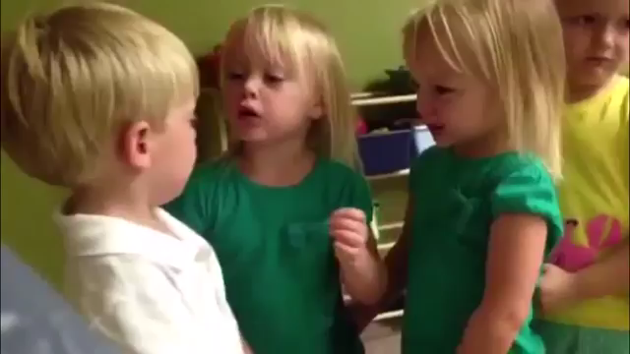
“You poked my heart”

